Slide 1
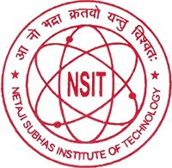
DAID - AN ANDROID APP FOR DISABLED
Vibhor Bijoy (384/CO/14)
Under the supervision of
DR M.P.S. Bhatia
DIVISION OF COMPUTER ENGINEERING
Netaji Subhash Institute of Technology
University of Delhi

Slide 2
PROBLEM STATEMENT
The main problem we focus here is
“Development of an android application to explore the scope of physically challenged people under gazette notification.”

Slide 3
IDEA FOR DAID APP
This app is based on the “Rule Based System”. Rule based System are a useful way to store and manipulate knowledge to interpret knowledge.
Rule Learning is a rule based machine learning method for discovering interesting relationship between variables and large databases .
Some of the rule based machine learning techniques are Learning Classifier System, Association Rule Learning and Artificial Immune System.

Slide 4
ABOUT THE APP
DIAD (Disability Aid) is an android application that would act as a guide for physically challenged people, who are facing problems to find career in life.
This app would provide various schemes suggested by the Indian government to help physically challenged people so that they find opportunities to excel in life.

Slide 5
TECHNOLOGIES USED
Android
Java (Backend)
Machine Learning (NLP)

Slide 6
Java
Java is a general-purpose computer-programming language that is concurrent, class-based, object-oriented, and specifically designed to have as few implementation dependencies as possible.
It is intended to let application developers "write once, run anywhere" (WORA), meaning that compiled Java code can run on all platforms that support Java without the need for recompilation.
Java applications are typically compiled to bytecode that can run on any Java virtual machine (JVM) regardless of computer architecture.

Slide 7
ANDROID SDK
The Android software development kit (SDK) includes a comprehensive set of development tools.]
These include a debugger, libraries, a handset emulator based on QEMU, documentation, sample code, and tutorials.
Currently supported development platforms include computers running Linux (any modern desktop Linux distribution), Mac OS X 10.5.8 or later, and Windows 7 or later.
As of March 2015, the SDK is not available on Android itself, but software development is possible by using specialized Android applications.
Android Studio made by Google and powered by IntelliJ, is the official IDE; however, developers are free to use others, but Google made it clear that ADT was officially deprecated since the end of 2015 to focus on Android Studio as the official Android IDE.

Slide 8
NATURAL LANGUAGE PROCESSING
Natural-language processing (NLP) is an area of computer science and artificial intelligence concerned with the interactions between computers and human (natural) languages, in particular how to program computers to fruitfully process large amounts of natural language data.
Some applications of NLP are Parsing, Natural Language Generation , OCR , Speech Recognition etc.
Challenges in natural-language processing frequently involve speech recognition, natural-language understanding, and natural-language generation.

Slide 9
APP FLOWCHART
INTRODUCTION
ENTER DETAILS
IF PATIENT DETAILS ARE TRUE
OTHERWISE
SYSTEM
FAILED
SCHEMES WOULD BE READ OUT
WRT DISABILITY
STOP

Slide 10
PROCEDURE
Firstly we enter the details of the user i.e (name and age).
After that we give the user choice whether he/she wants to read the schemes in a documented form or listen the schemes in audio form.
Depending on user’s choice the desired action is performed.
The pdf files are manually converted into txt format and then shown in the application

Slide 11
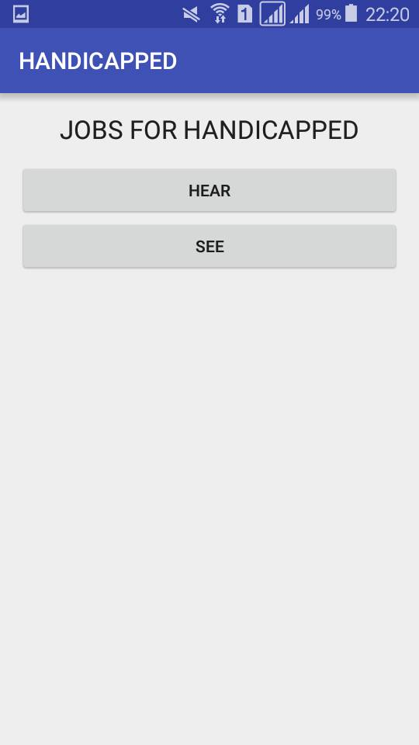
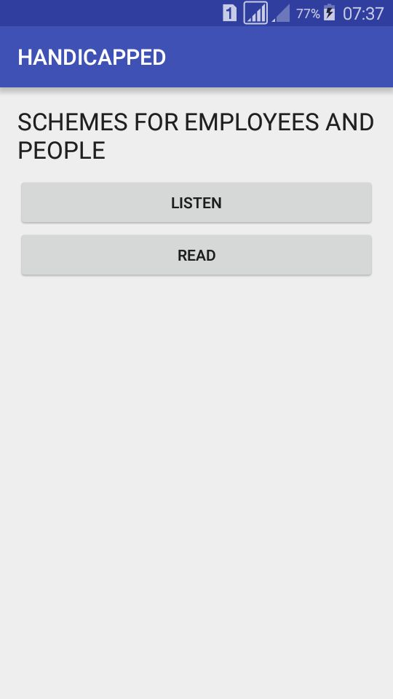
OUTPUTS/ RESULTS

Slide 12
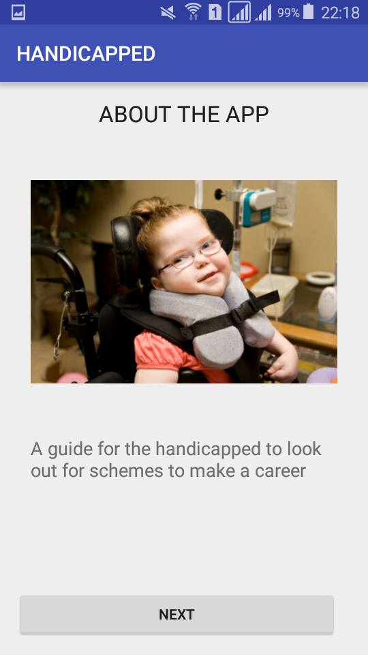
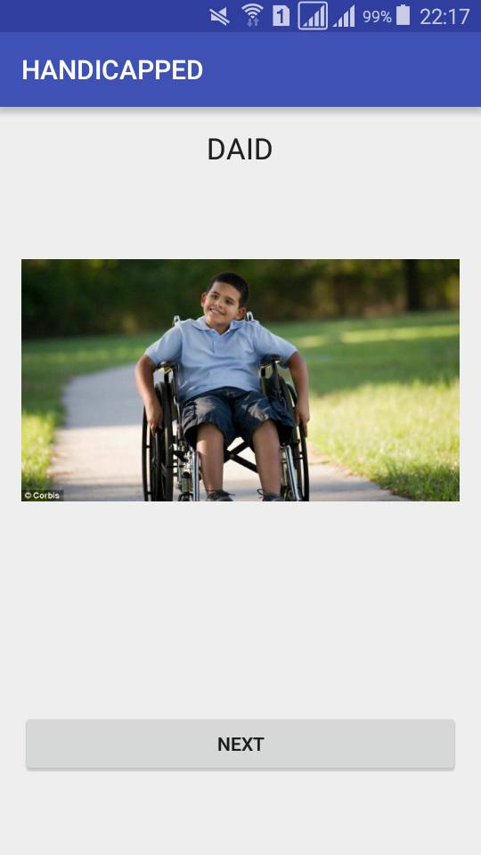
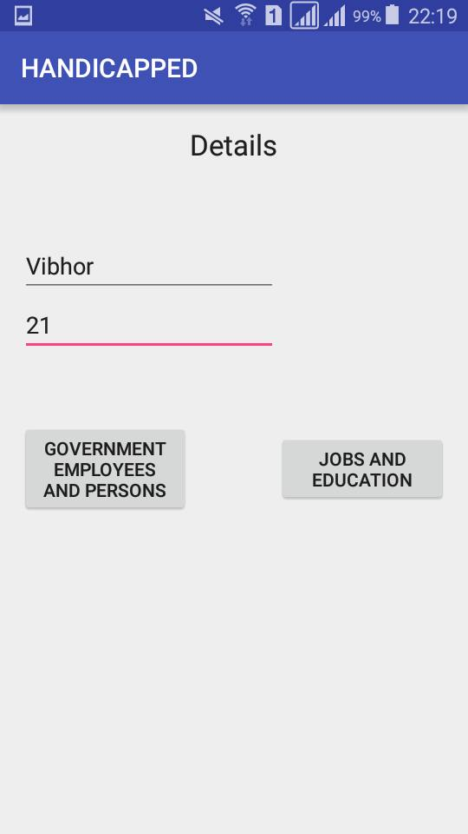
RESULTS CONTINUED

Slide 13
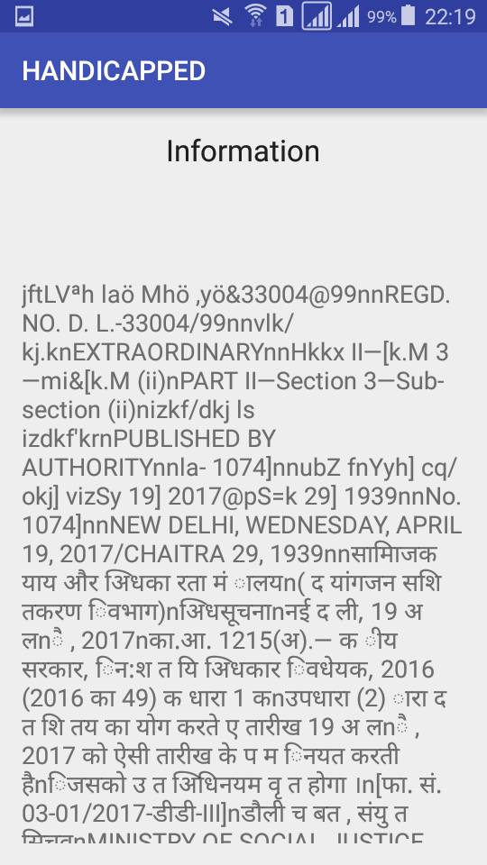
RESULTS

Slide 14
CONCLUSIONS
On the basis of the results mentioned in the previous slides and the audio played on the device, we conclude that our objective of developing an android application whose aim was to explore the scope of opportunities for the physically challenged people under gazette notification is achieved.

Slide 15
SCOPE OF IMPROVEMENT
We can integrate a chatbot in our android application in which user can enquire about the schemes that are being told to him .
We can also integrate a language input type in which user can enter the language of his choice and audio will be played in that language .
Similar thing can take place in case of a chatbot in which user can select language of his choice and type his query in that language. Hence his query will also be replied in that language.

Slide 16
REFERENCES
I have taken the idea of my project from the following papers:
Chatbot using a database by Bayu Setiaji Department of Informatics Engineering STMIK AMIKOM Yogyakarta , Indonesia.
Android Based Speech Recognition by Sonali Thite1, Archana Gore ,Sagar Yelmar Dept.of Computer-Science, Karmayogi Engineering College, Shelve Pandharpur
A mobile communication aid system for persons with physical disabilities by Cheng-Huei Yanga.

Slide 17
THANK YOU

